Slide 1

Detection Masking for Improved OCR on Noisy Documents
Daniel Rotman*, Ophir Azulai*, Inbar Shapira, Yevgeny Burshtein, Udi Barzelay
IBM Research AI - Haifa
Document Intelligence Workshop

Slide 2
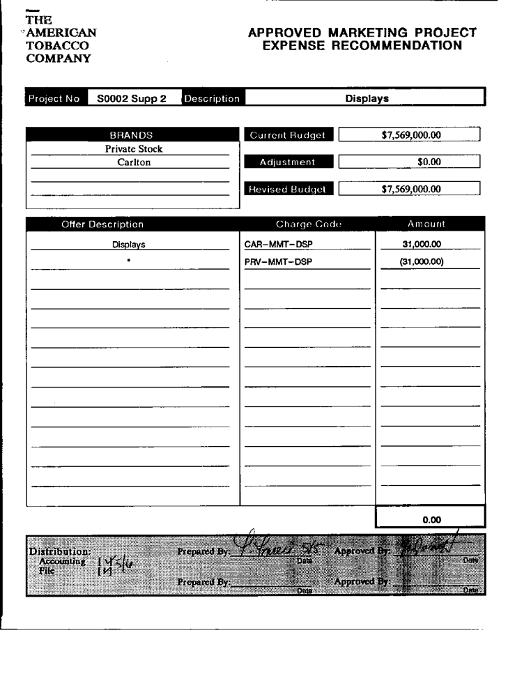
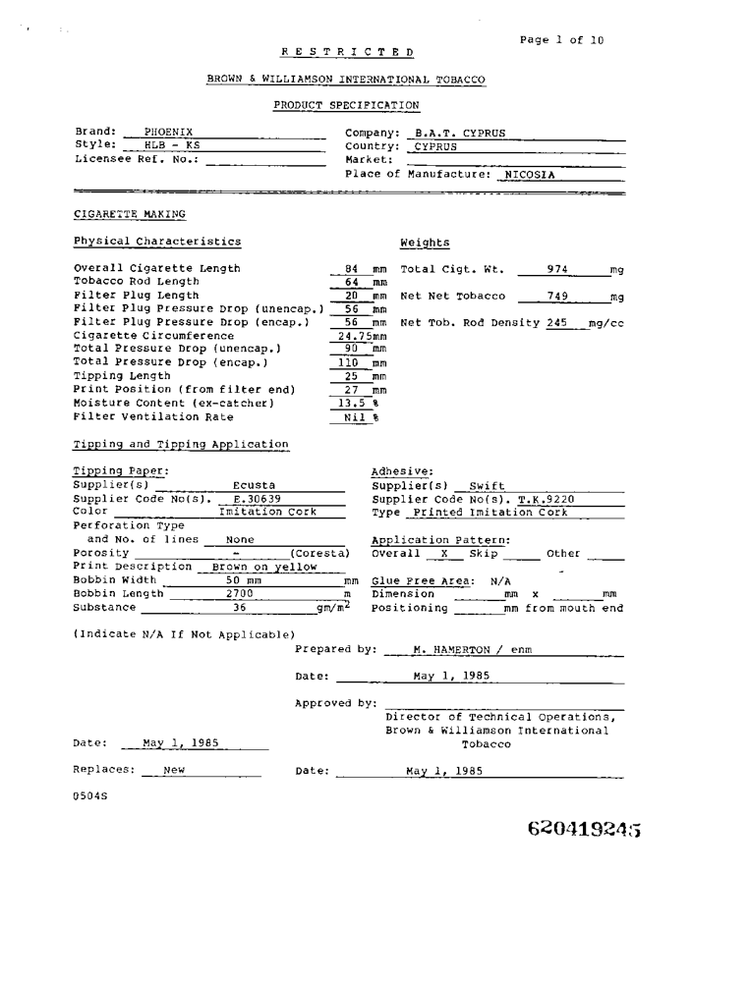
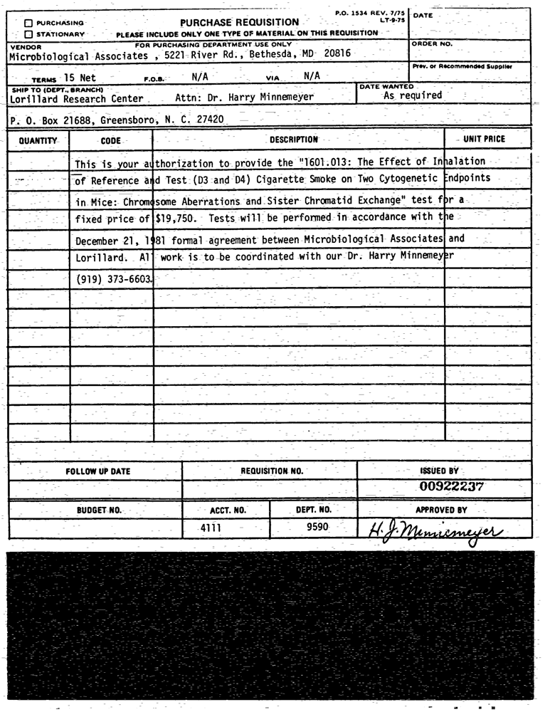
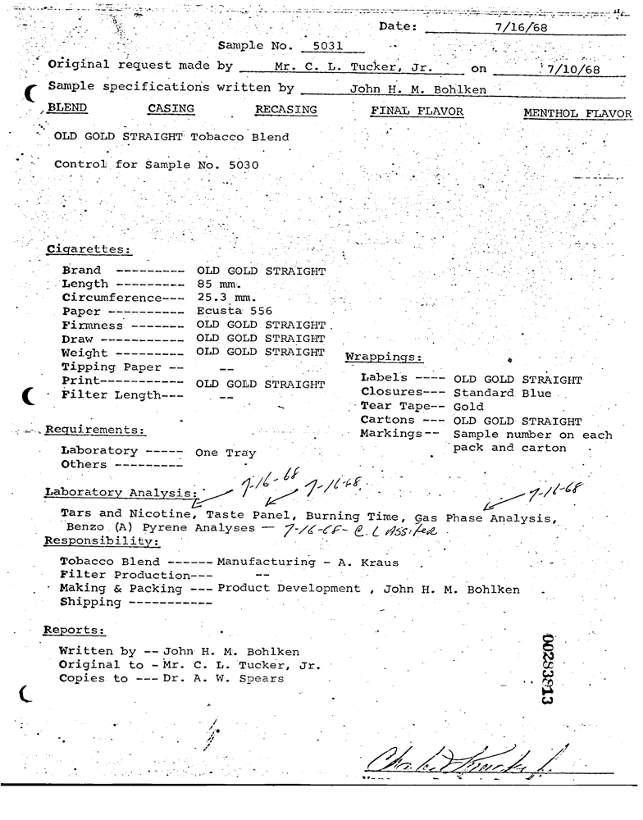
OCR for Noisy Documents
Detection Masking for Improved OCR on Noisy Documents
Optical Character Recognition (OCR) is a cornerstone technology for information extraction from documents
Commodity OCR engines exhibits degraded results on noisy documents – scanning artifacts, lines or non-textual elements such as logos, figures, and graphical elements

Slide 3
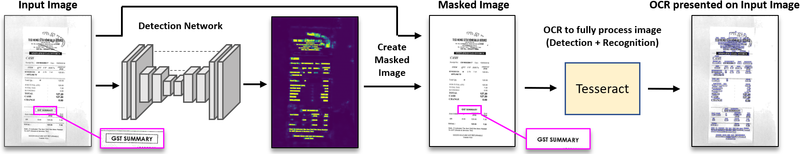
Overview
Detection Masking for Improved OCR on Noisy Documents
We propose a system to improve OCR results on degraded documents
A new data synthesis approach with a hard-negative component
Designated U-Net architecture for efficient detection in noisy documents
Masking formulation to apply off-the-shelf OCR in a robust fashion

Slide 4
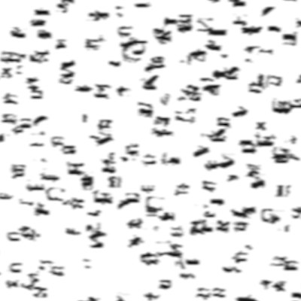
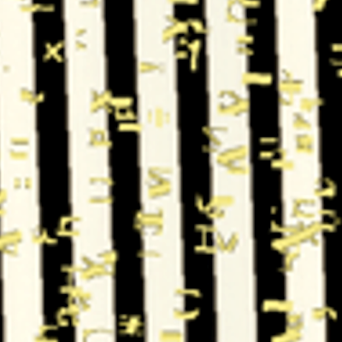
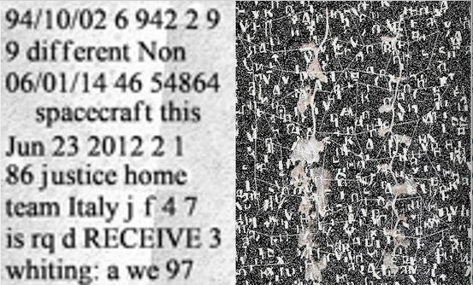

Data Synthesis
Detection Masking for Improved OCR on Noisy Documents
Hard-Negative samples
Backgrounds: plain, texture, natural image
20% unique fonts
Aggregated character-level ground truth
Font-level noise: speckled, binarized, spatial distortions
Small rotations + blur/compression/down-sampling

Slide 5
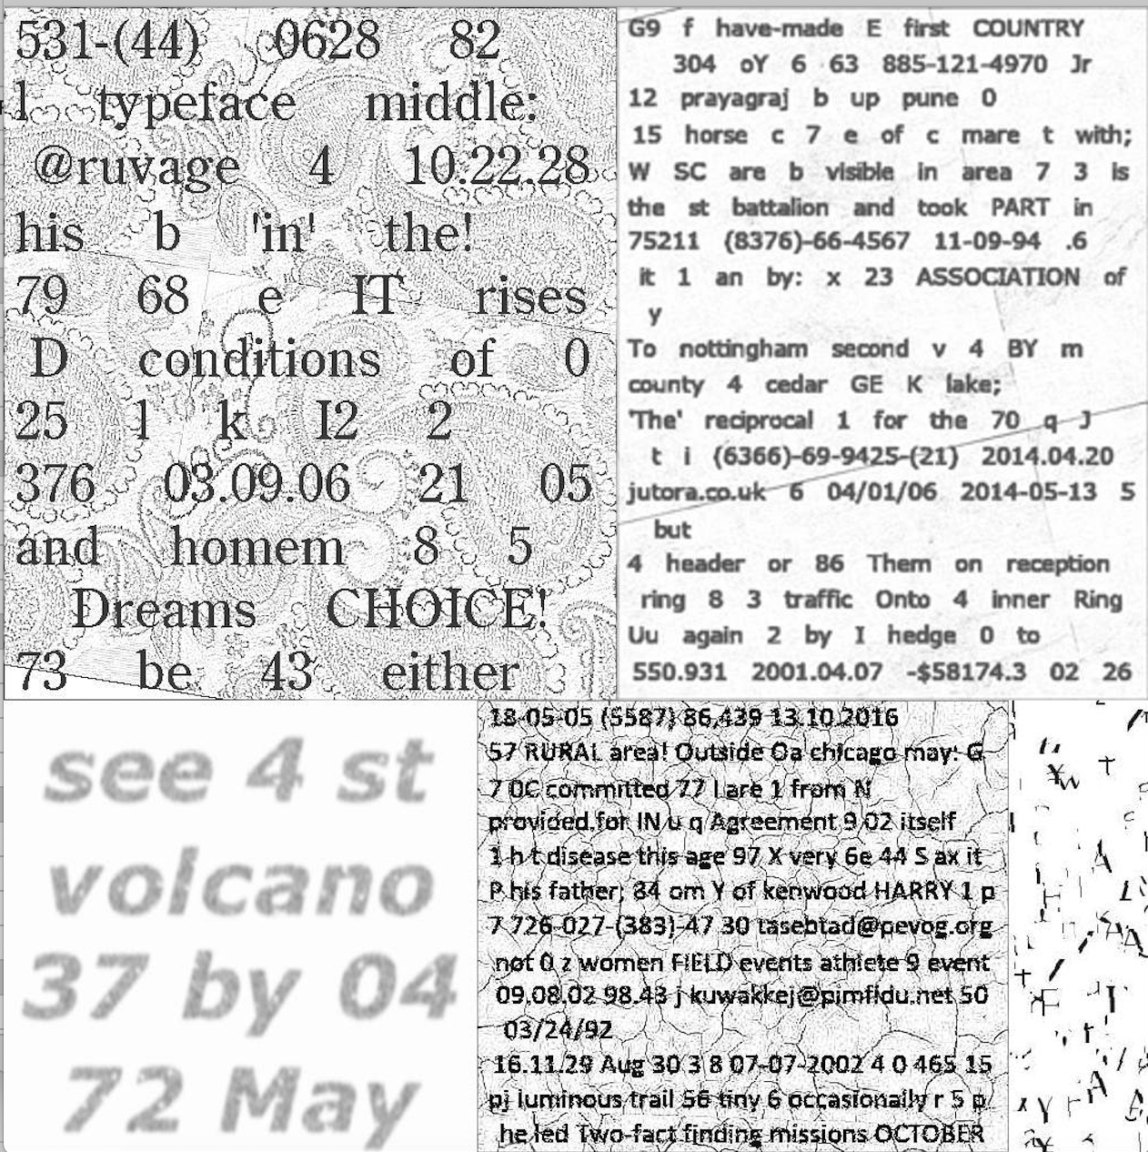
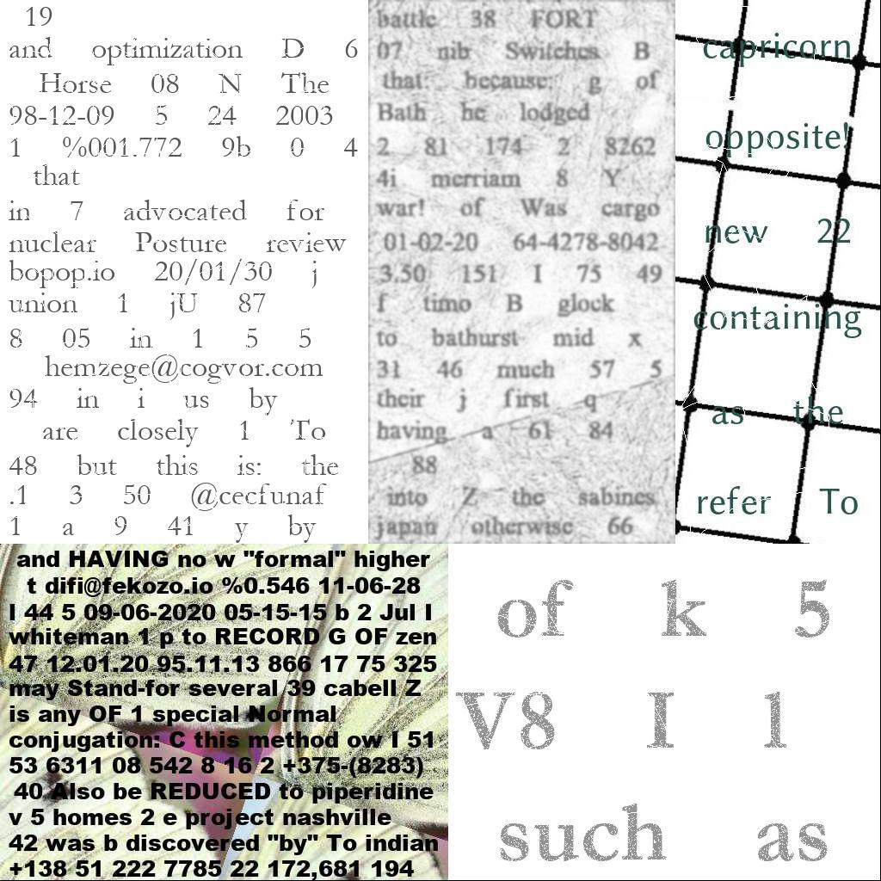
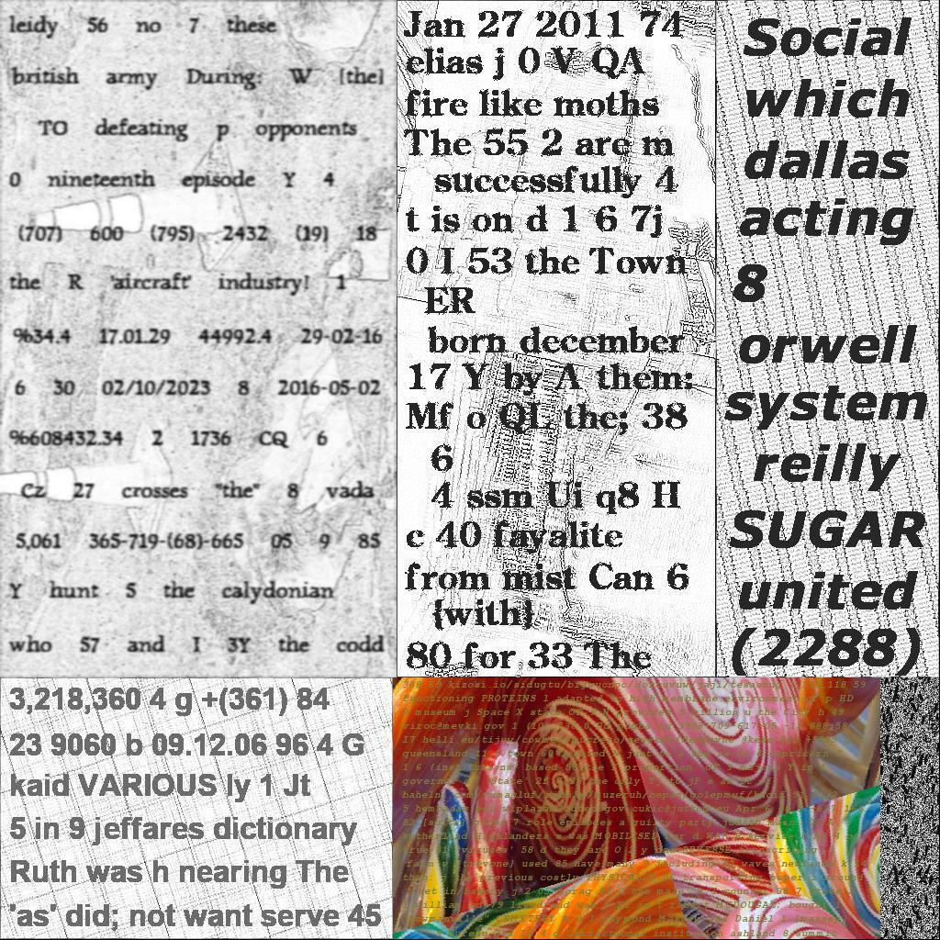
Data Synthesis – Examples
Detection Masking for Improved OCR on Noisy Documents

Slide 6
Detection Network Masking
Detection Masking for Improved OCR on Noisy Documents
U-Net architecture trained on hard-negative synthesized dataset
Document is masked in areas not detected

Slide 7
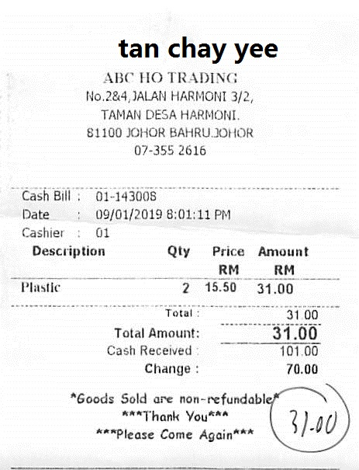
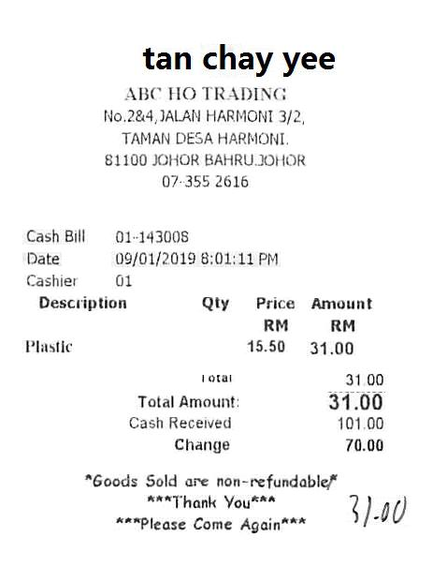
Detection Network Masking - Examples
Detection Masking for Improved OCR on Noisy Documents

Slide 8
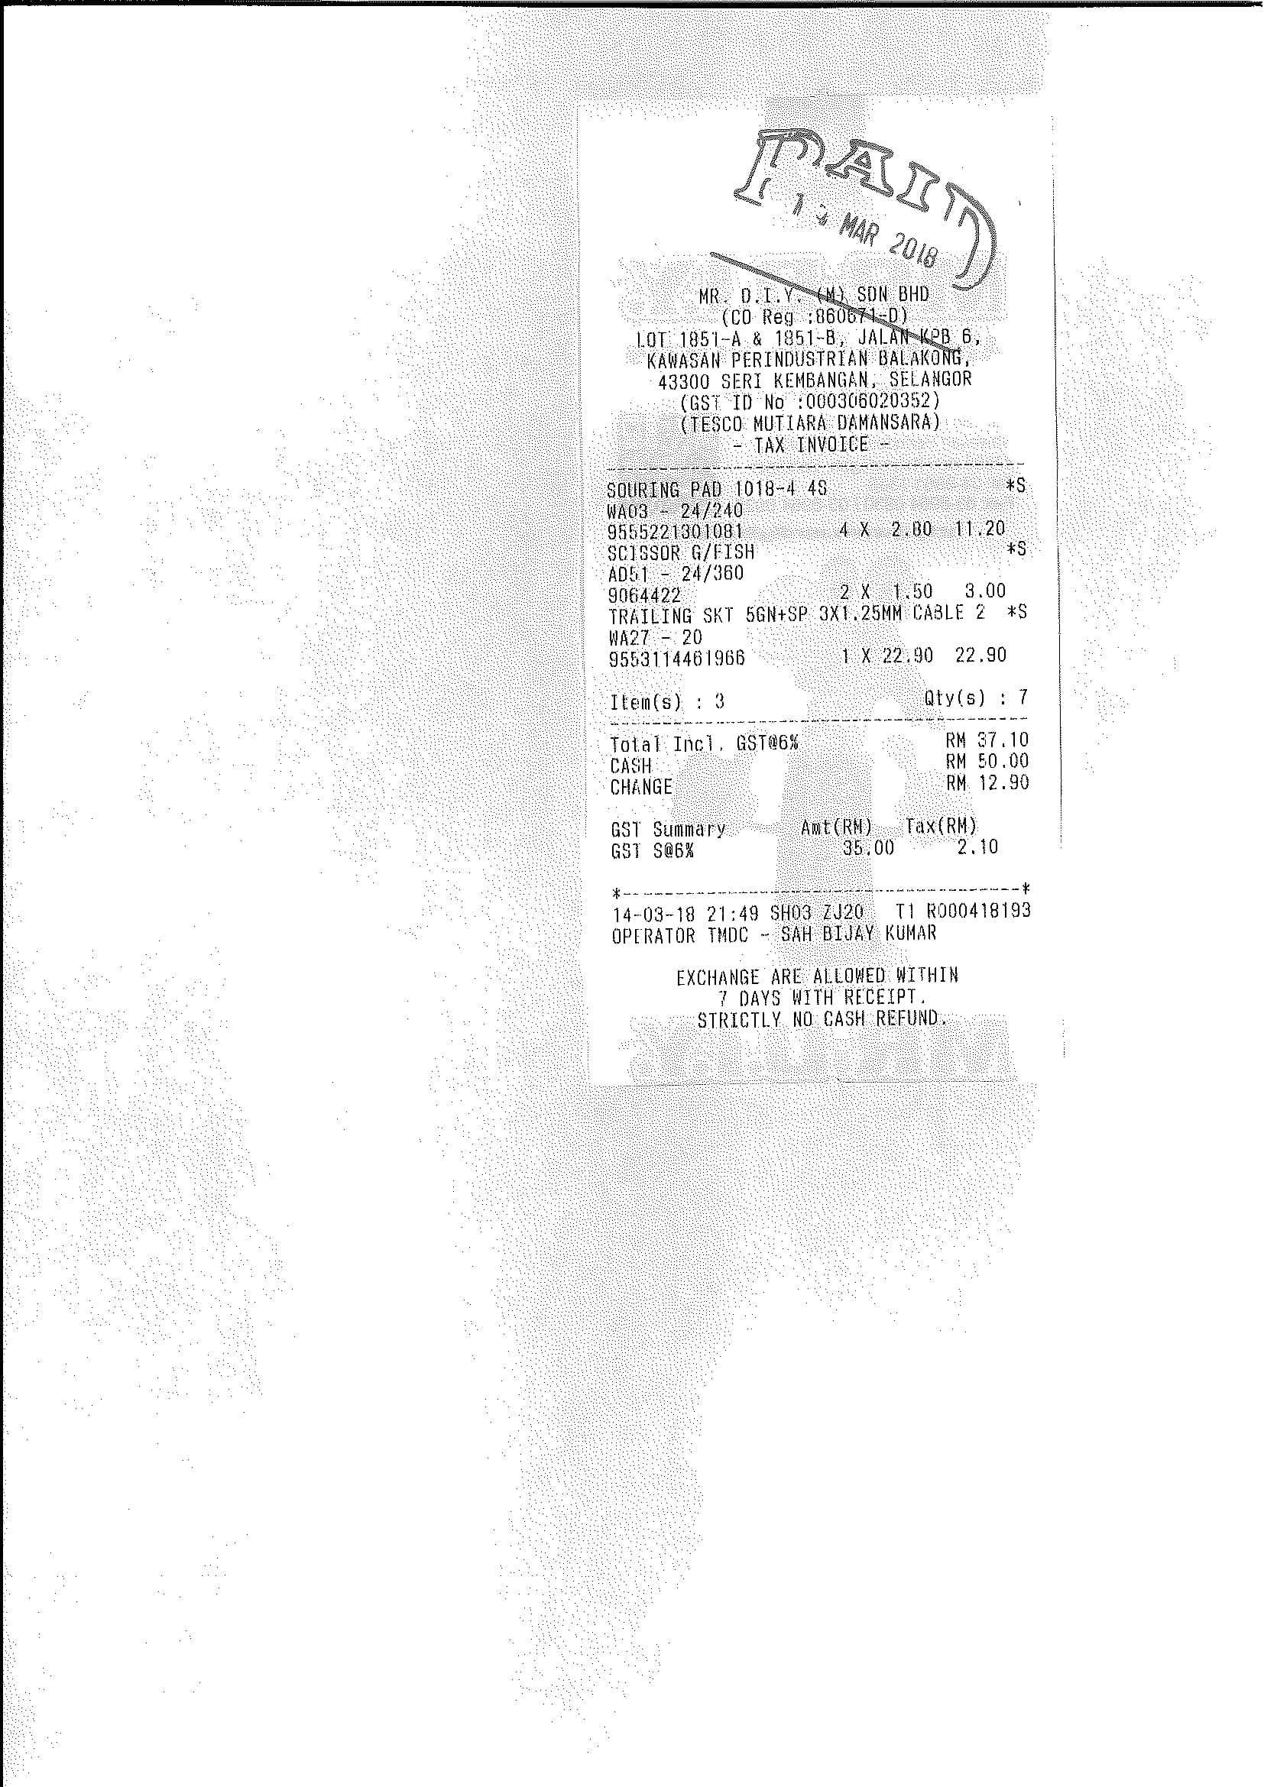
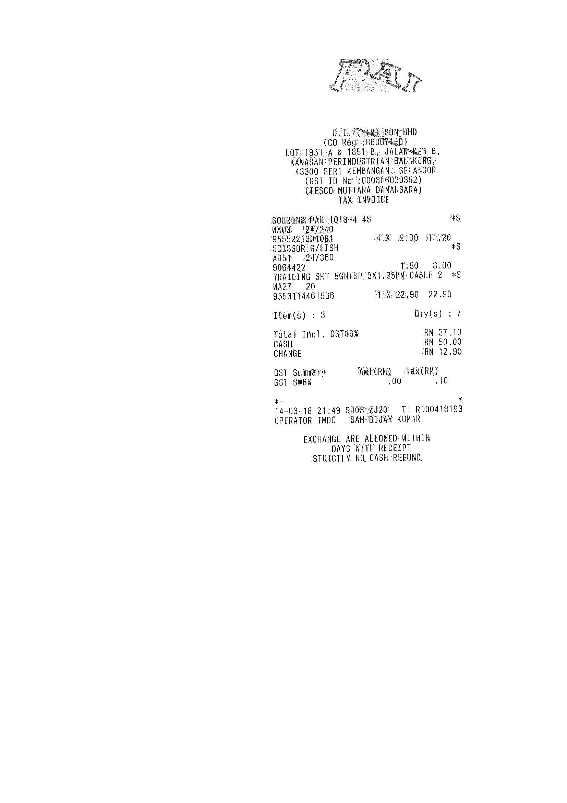
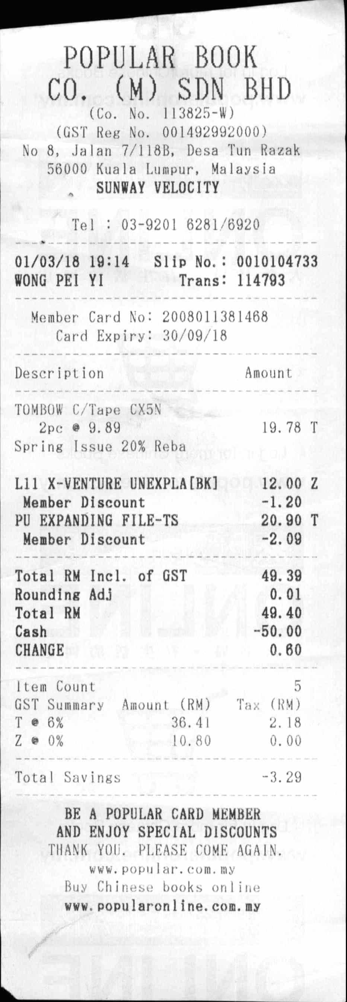
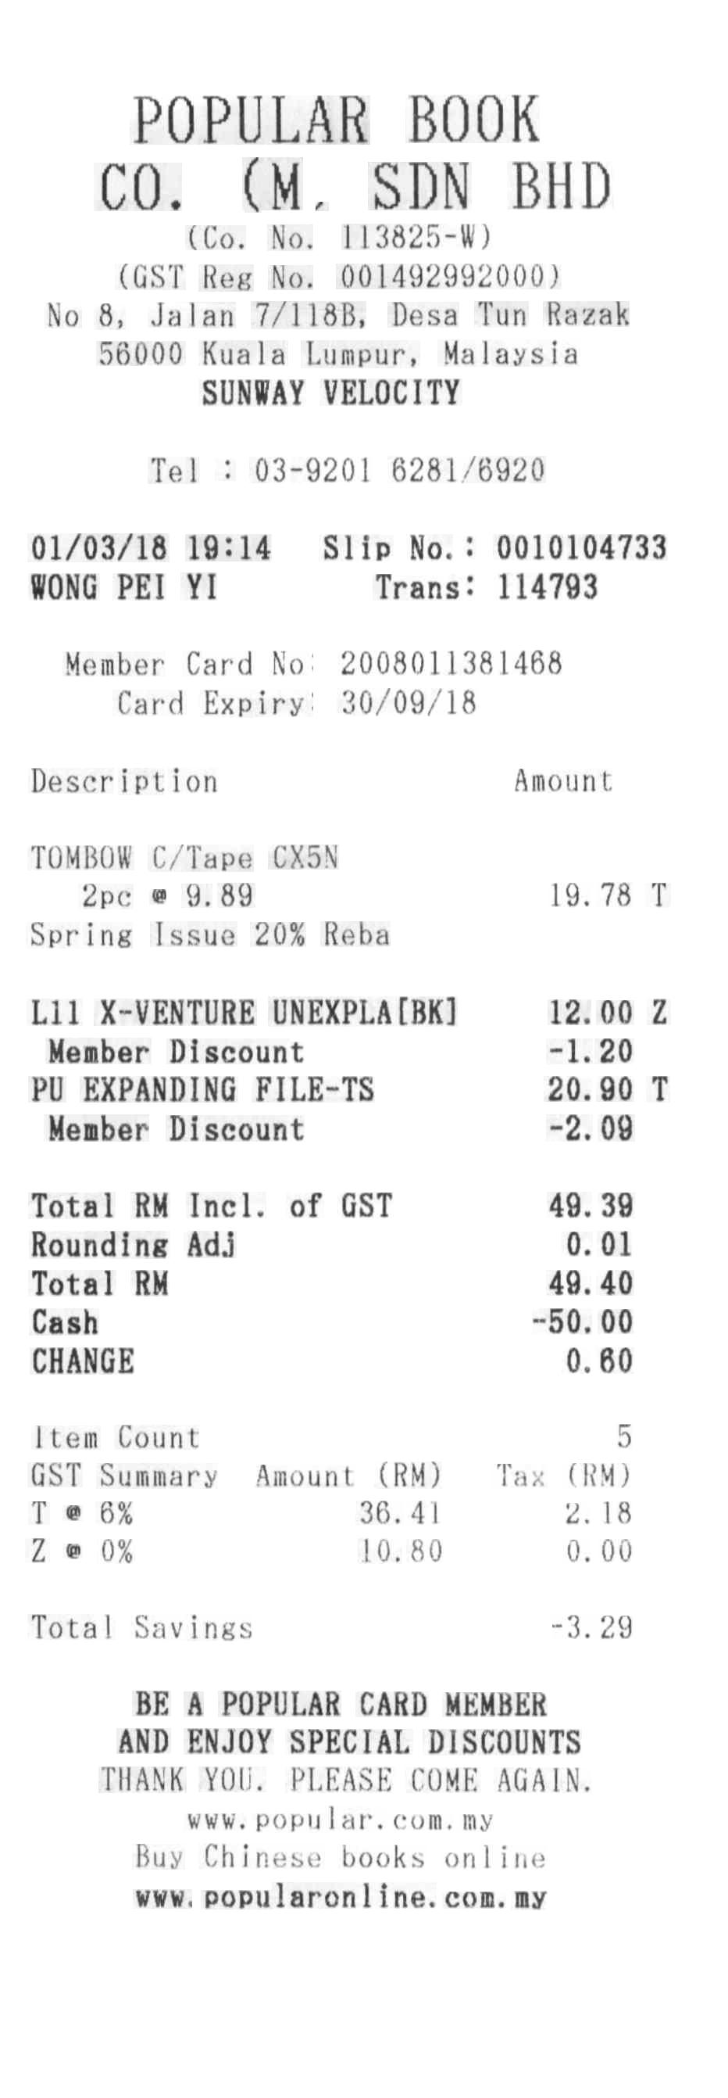
Detection Network Masking - Examples
Detection Masking for Improved OCR on Noisy Documents

Slide 9
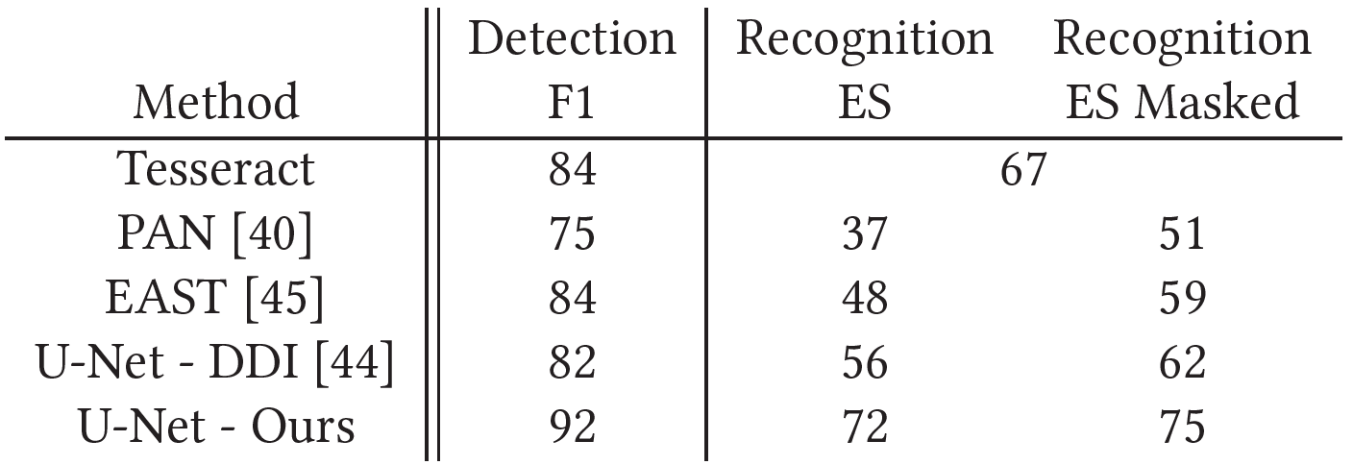
Experiments
Detection Masking for Improved OCR on Noisy Documents
SROIE (ICDAR19 – 1064 scanned receipts)
Tesseract
Comparison to DDI-100 dataset
Comparison to two SOTA text detectors

Slide 10

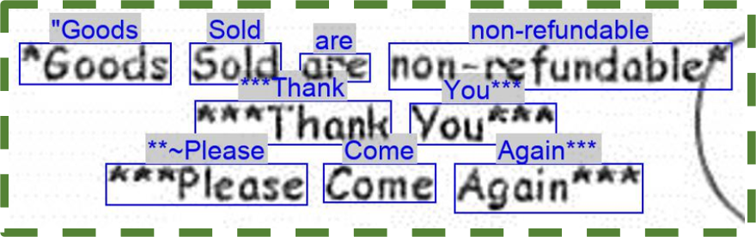
Limitations
Detection Masking for Improved OCR on Noisy Documents
Latin alphabet
Likely Natural Scene Text (NST) could achieve better performance
Masking is utilized mostly for context; a designated OCR might be able to overcome the benefits

Slide 11

Conclusions
Detection Masking for Improved OCR on Noisy Documents
A new hard-negative synthesized document dataset https://github.com/ophirazulai/SyntheticNoisyDocsDataset
Widely applicable masking technique
More details in the paper
Questions?

